Slide 1
Formal Verification With Confidence Intervals to Establish Quality of Service Properties of Software Systems
Presented by:
BHAGIRATHI NAYAK
RAJEEV RANJAN
ANIRUDH SUNDAR SUBRAMANIAM
VINOD SUBHASH CHHAPARIYA

Slide 2
Authors
Radu Calinescu, Senior Member, IEEE
Carlo Ghezzi, Fellow, IEEE
Kenneth Johnson, Member, IEEE,
Mauro Pezzé, Senior Member, IEEE
Yasmin Rafiq, Student Member, IEEE,
Giordano Tamburrelli
Date of publication : August 04, 2015

Slide 3
MOTIVATION
Transition probabilities of Markov Chains are much more difficult to establish correctly.
Current practice include point estimates provided by domain experts which is often affected by unquantified estimation errors.
Sometimes transition probability can’t be determined for certain Markov Chains.
Is it still possible to do quantified verification on such type of Markov Chains?
This paper addresses the following issue.
“In this paper, we extend the applicability of quantitative verification to the common scenario when the probabilities of transition between some or all states of the Markov models analyzed by the technique are unknown, but observations of these transitions are available”

Slide 4
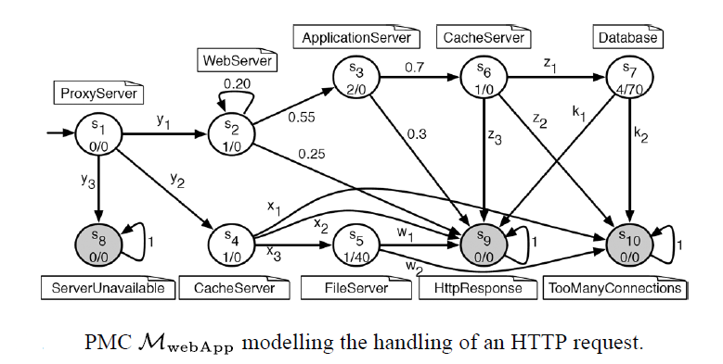
CASE STUDY-I

Slide 5
MODEL IN DETAILS
To serve client requests, the web application accesses structured data stored in a
database, and static content located on a file server. Both types of content are cached by ad-hoc cache servers.
n1/n2 labels in state
n1 corresponds to average cost of the operation in tenths of a cent.
n2 corresponds to average duration in milliseconds.

Slide 6
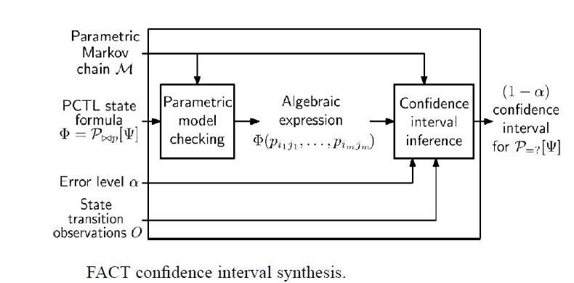
FLOW OF THE ANALYSIS

Slide 7
TERMS USED
Parametric Markov Chain
It is a Markov chain for which some of the transition probabilities are parameters with domain [0 ,1].
Sample input:
state: [0..3] init 0;
[] state=0 -> p1:(state'=1) + p2:(state'=3) + (1-p1-p2):(state'=2);

Slide 8
TERMS USED CONTD.
PCTL PROPERTY
It is used to specify property in DTMCS,PMC,etc.
Example :
What is the probability of finally getting into state2?
Sample input:
P=? [ F state=2 ]

Slide 9
TERMS USED CONTD.
ERROR LEVEL
Maximum permissible Error in the results.
OBSERVATION FUNCTION
Run the model for a long time and observe the no. of transitions taken. Example Below
shows there are 2705 transitions from state s1 to s2,3174 trsanistions from s1 to s4,and so on.

Slide 10
TERMS USED CONTD.
PARAMETRIC MODEL CHECKING
For model checking we used “PRISM 4.3.1”,it supports PMC.
Input: 1.PMC
2.PCTL PROPEPRTY
Output: An algebraic expression for the corresponding PCTL property

Slide 11
TERMS USED CONTD.
CONFIDENCE INTERVAL INFERENCE
FACT TOOL CHAIN is used along with YALMIP for optimization.
Input:
1.Algebraic Expression
2.PMC
3.Obesrvation
4.Error level
Output:
A graph containing the confidence intervals varying the error level within a given range.

Slide 12
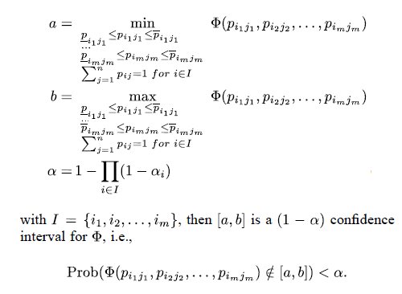
TECHNICAL DETAILS
Proposition 1
After prism processes the PMC,it gives a an algebraic expression,for example ø(x₂y₂) .Then we already have the prob. range of x2 , y2 from proposition 2.so to find the range of the given property we do the following:

Slide 13
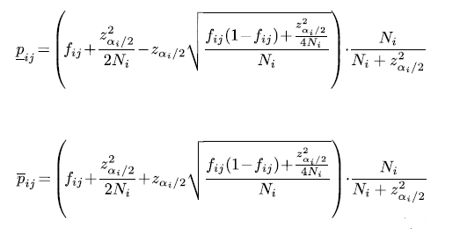
TECHNICAL DETAILS
Proposition 2
It calculates the range of probability to be used in proposition 1 for every single parameter in the PMC.

Slide 14
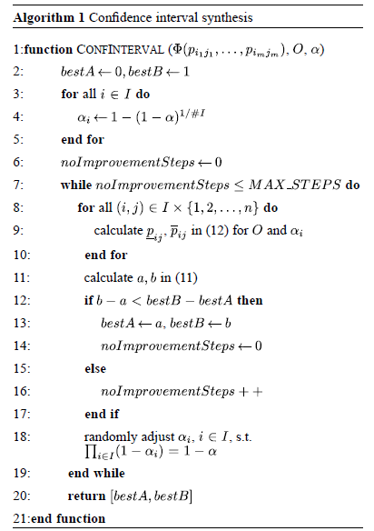
TECHNICAL DETAILS

Slide 15
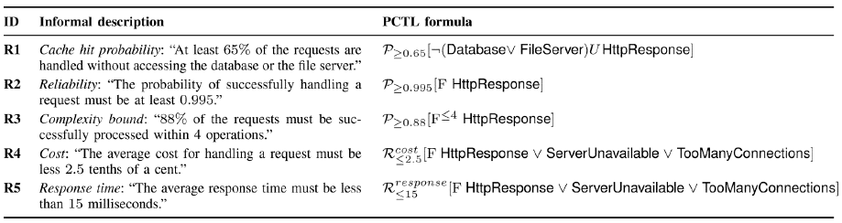
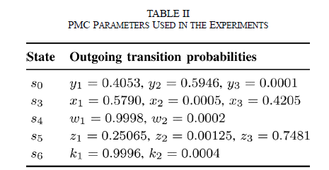
RESULTS
INPUT:

Slide 16
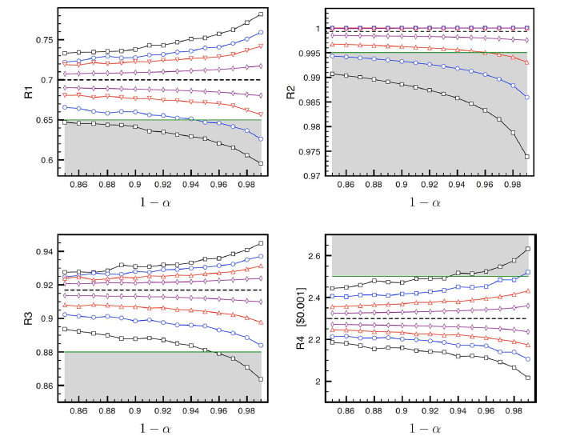
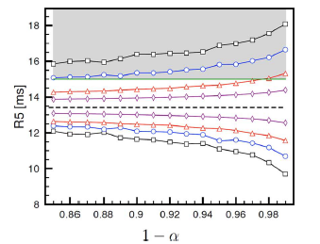
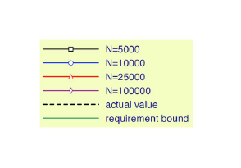
RESULTS

Slide 17
TEST CASES
Web Application(Paper)
Tele Assistance(Website )
Cricket(Real Life)
Water Filter(Real Life)

Slide 18
Web Application

Slide 19
PCTL Properties

Slide 20
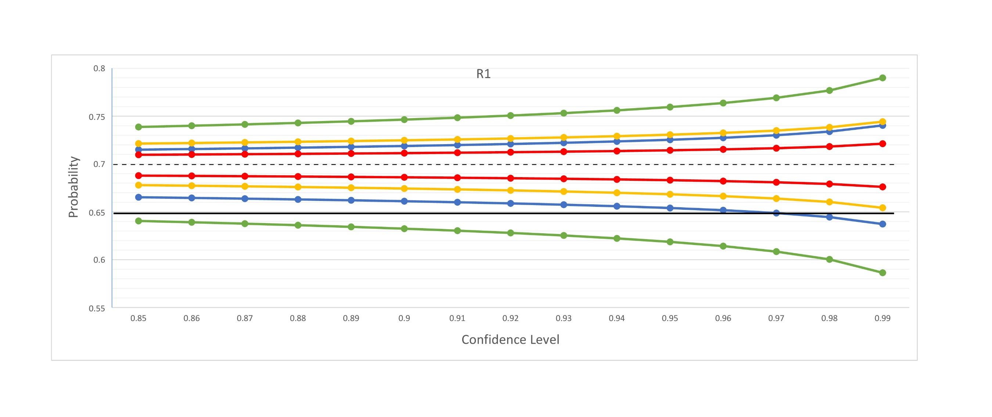
Web Application
R1

Slide 21
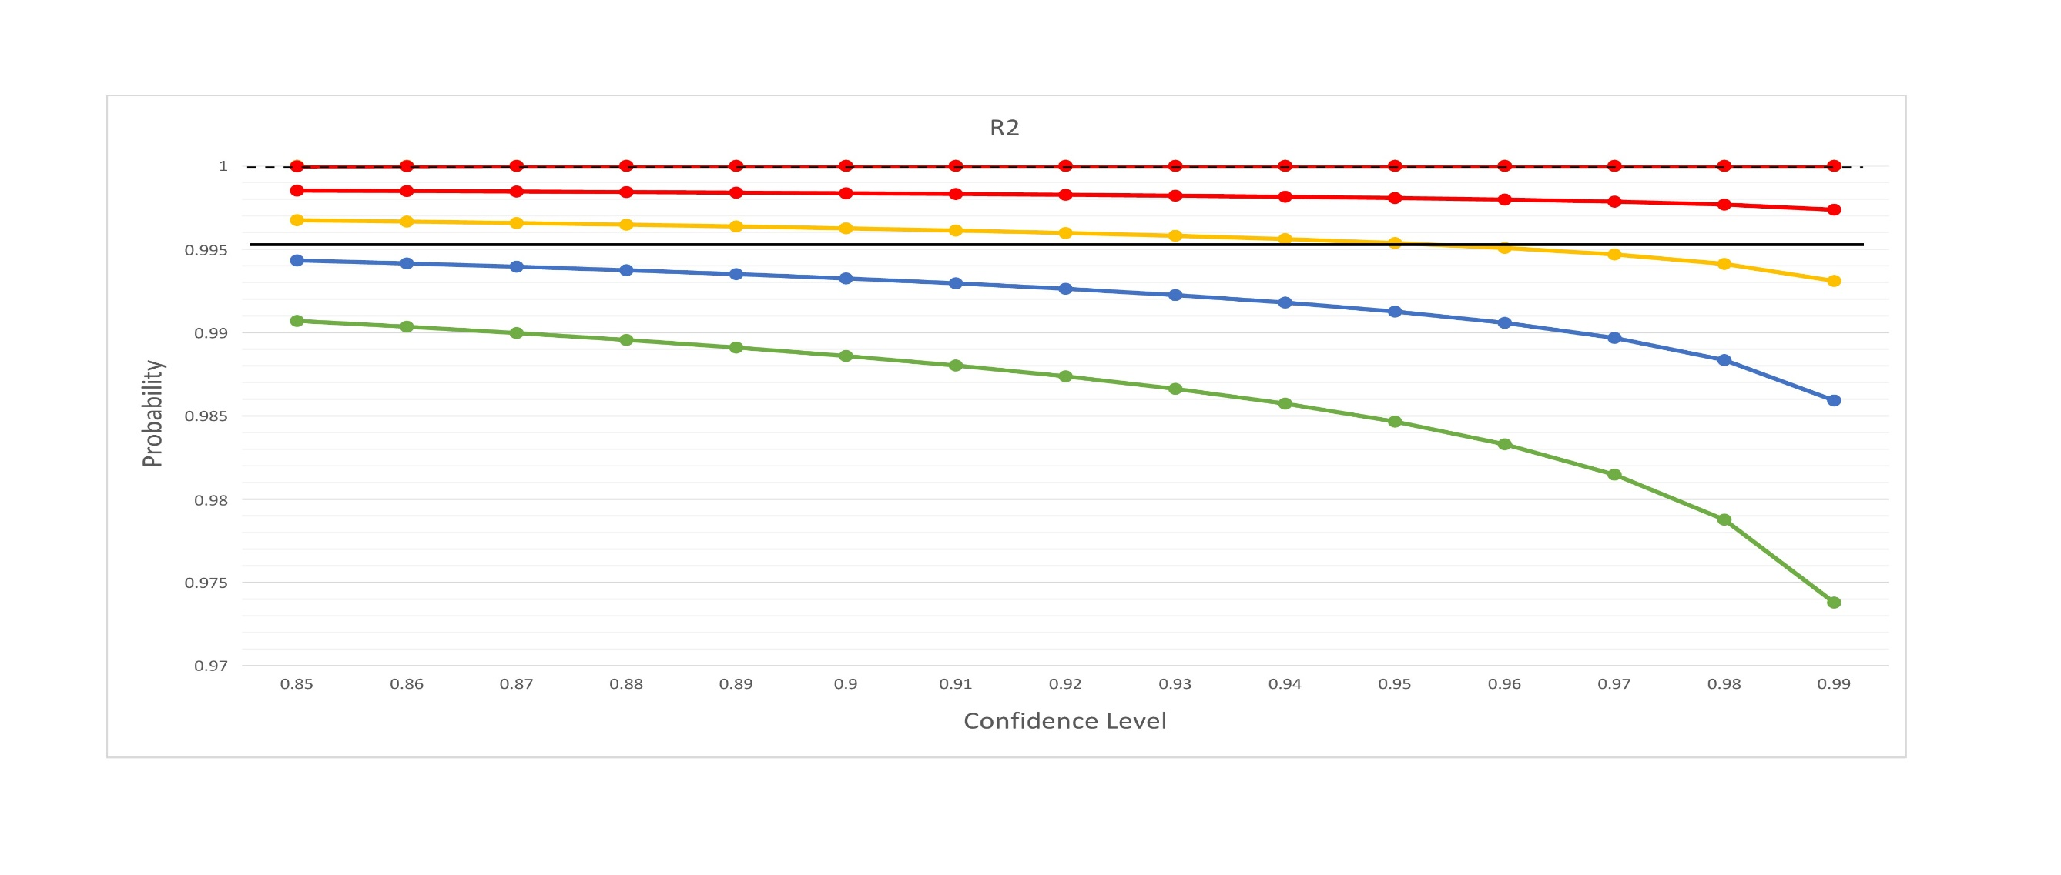
Web Application
R2

Slide 22
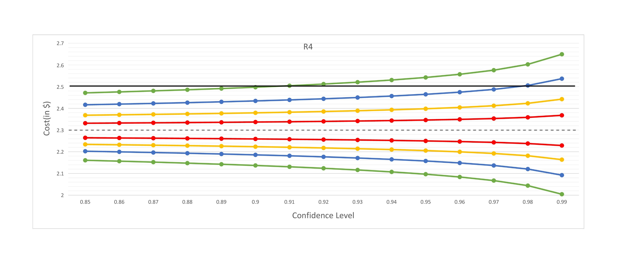
Web Application
R4

Slide 23
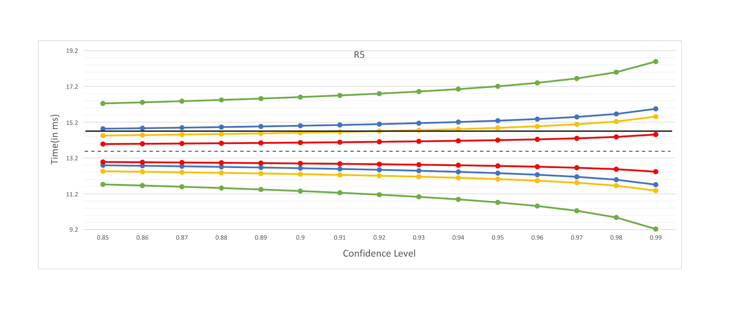
Web Application
R5

Slide 24
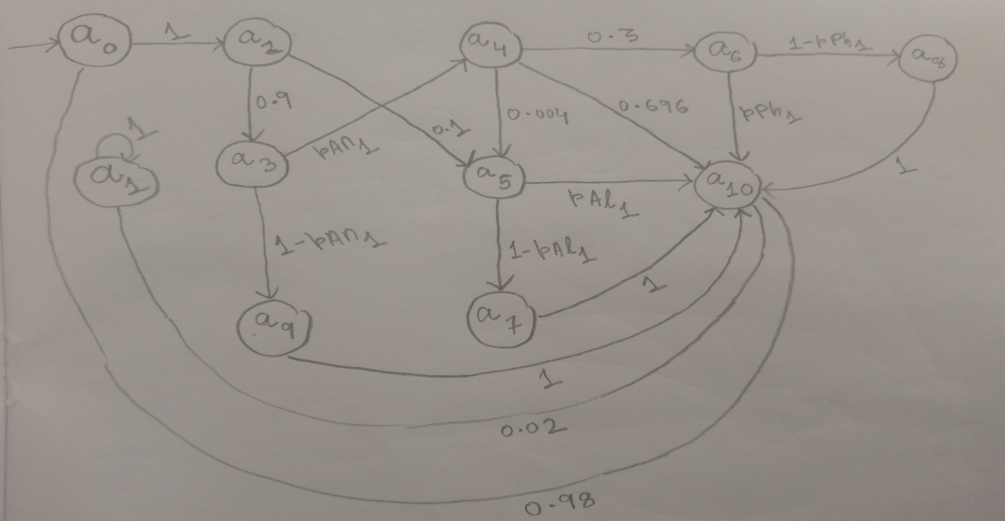
Tele Assistance

Slide 25
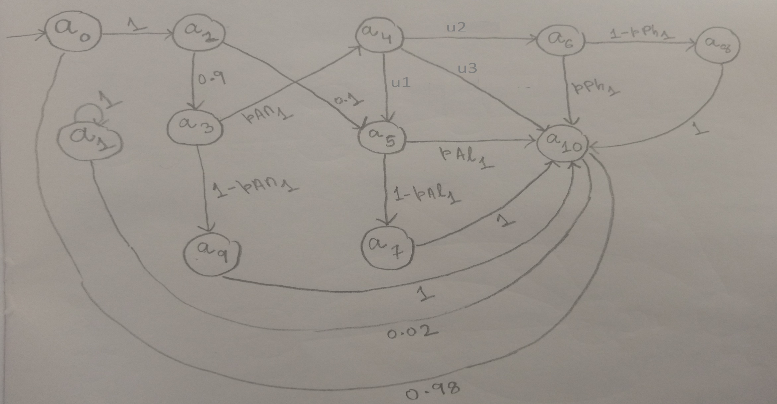
Tele Assistance-Modified

Slide 26
PCTL Properties
P=?[F "failedAlarm"]
P=?[!"done" U "failedService"]
P=?[!"done" U "failedAlarm" {"analysis"}]

Slide 27
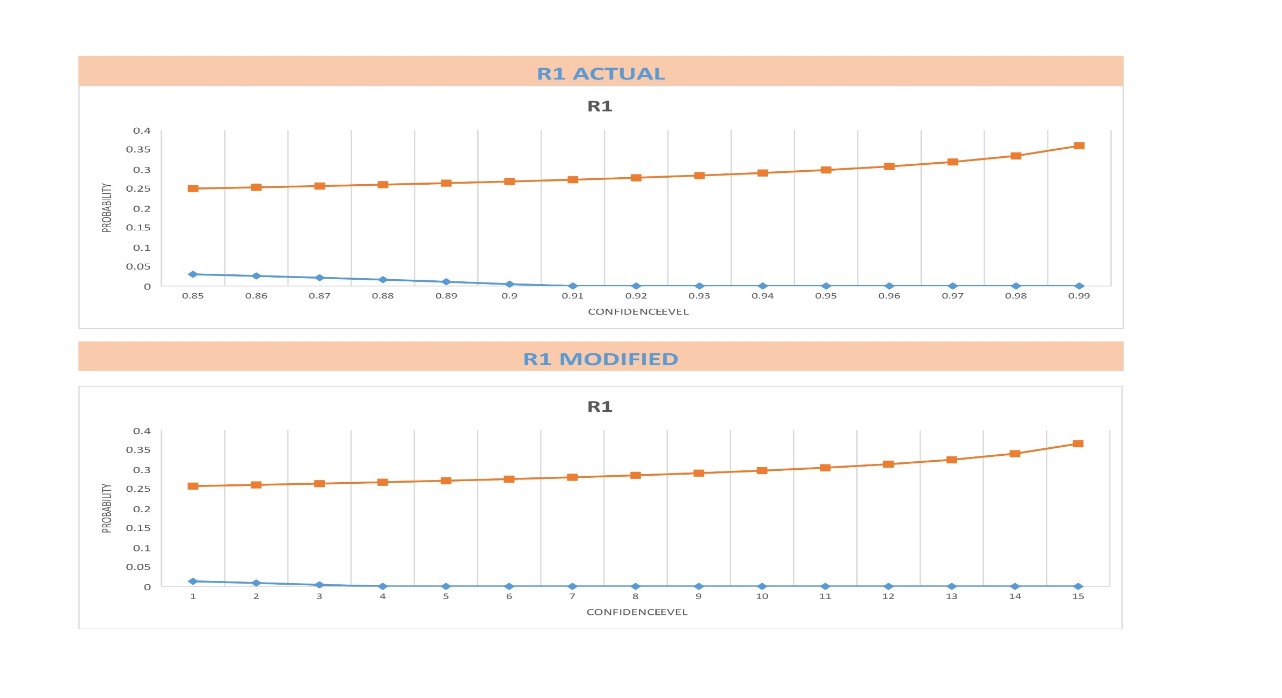
Tele Assistance
R1

Slide 28
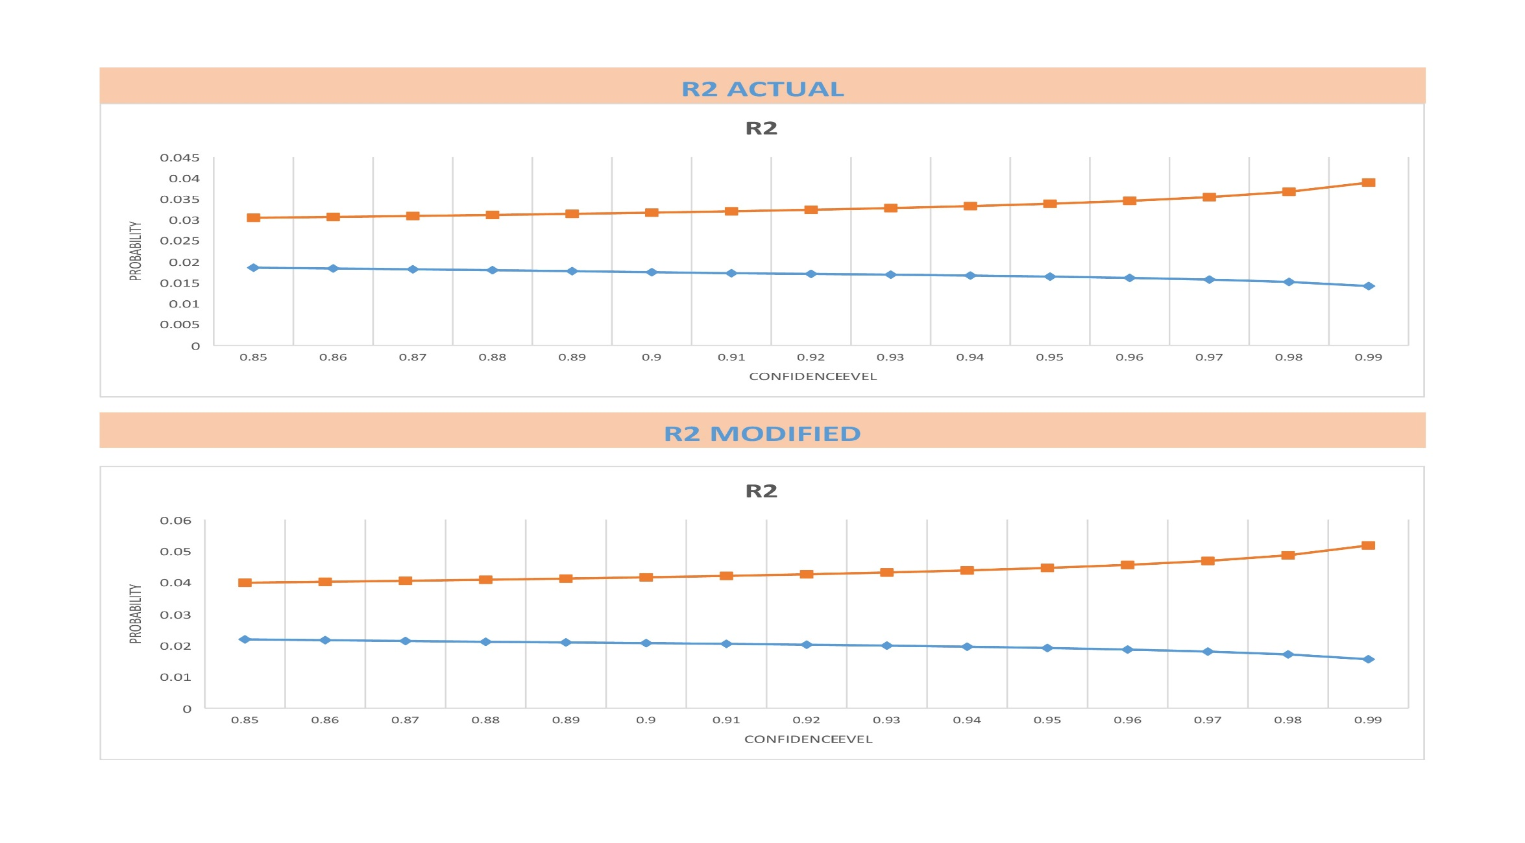
Tele Assistance
R2

Slide 29
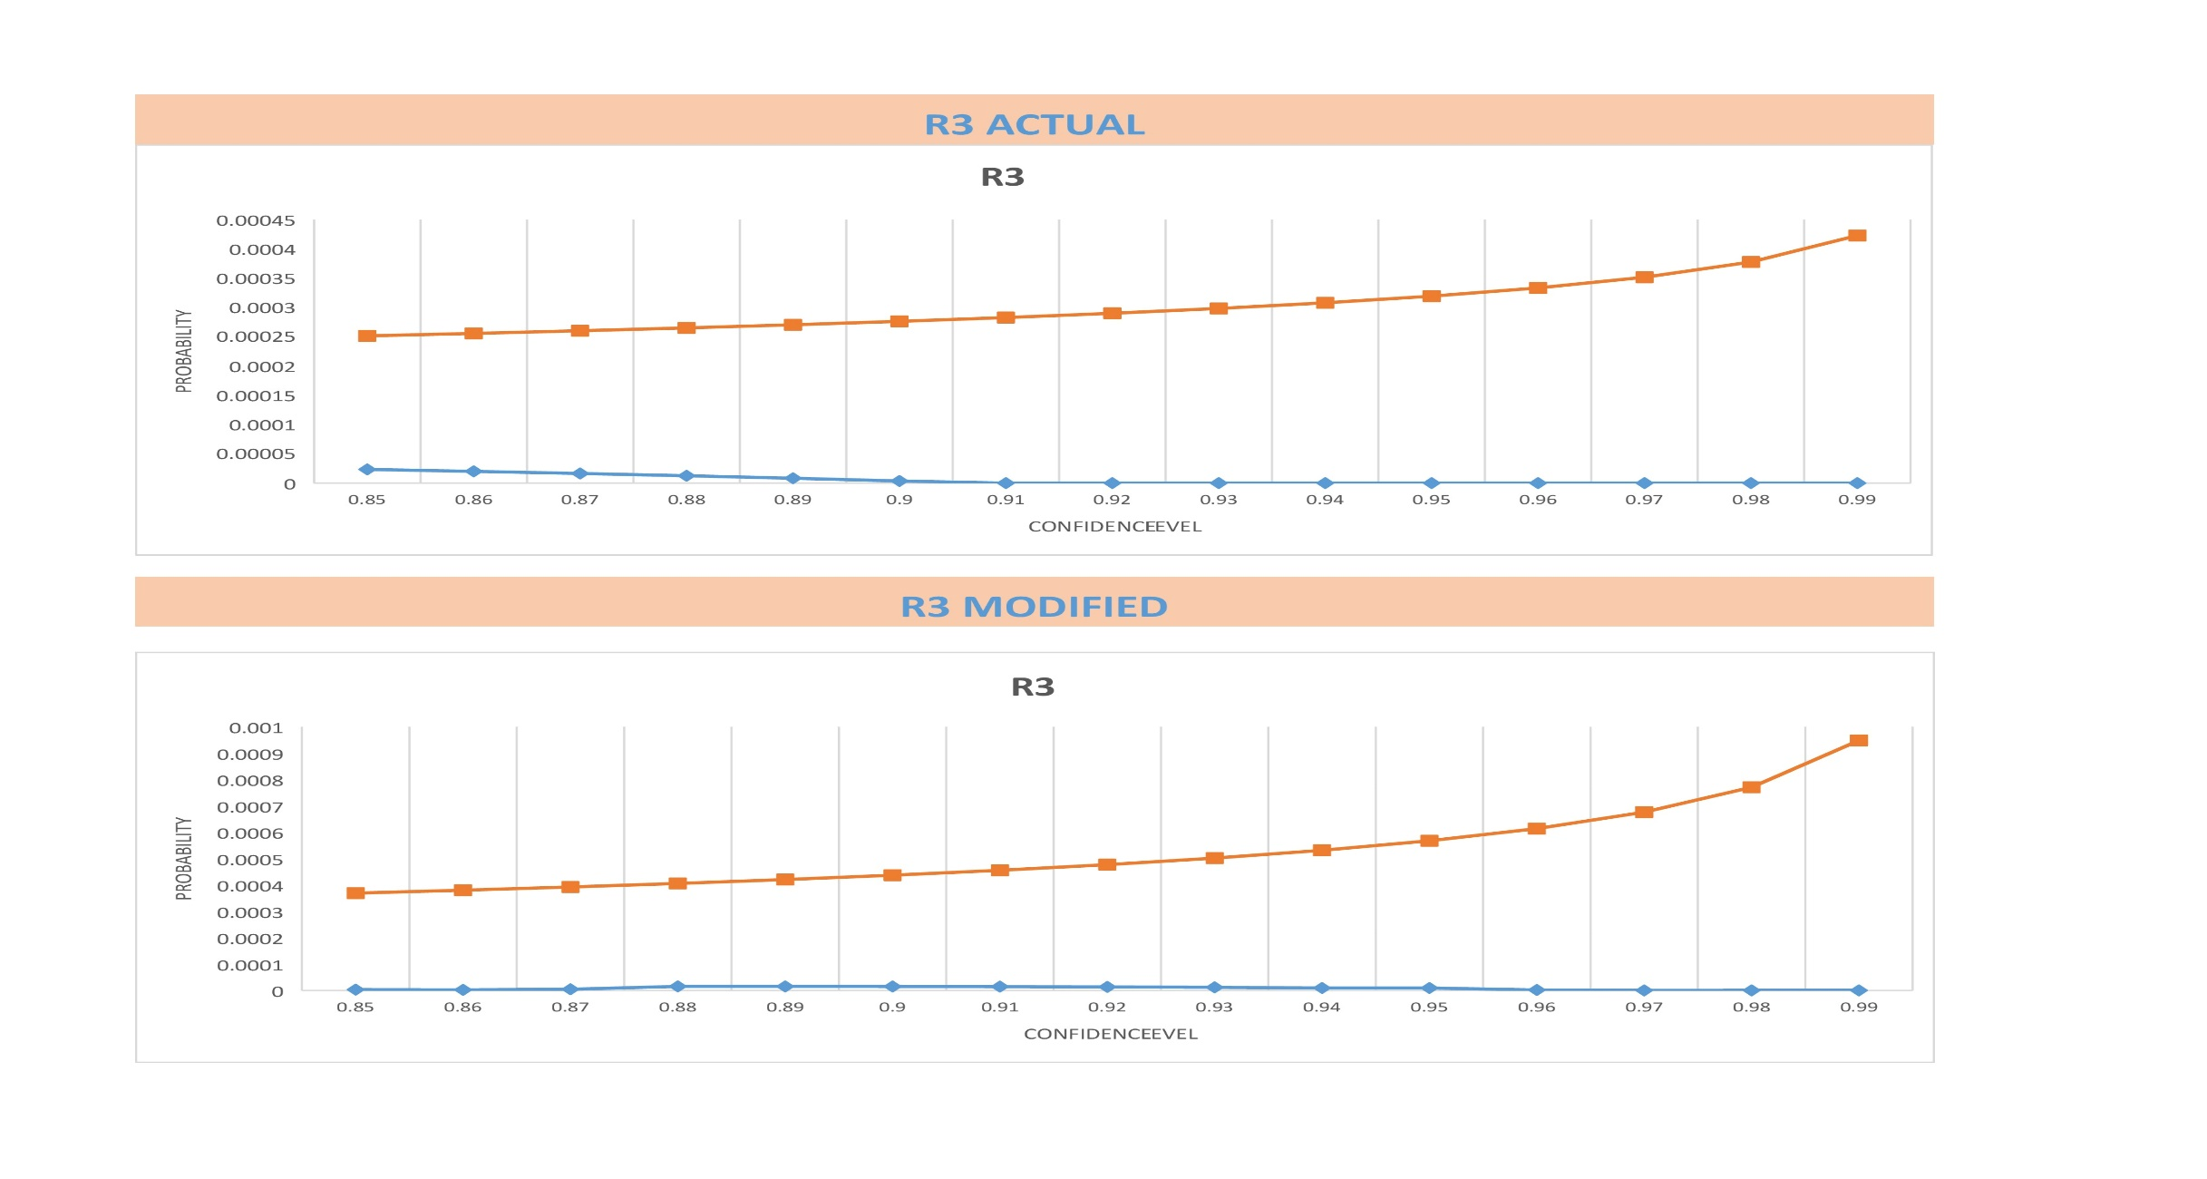
Tele Assistance
R3

Slide 30
Cricket
We collected the statstics of performance of Virat Kohli in One day International matches.
On basis of number of balls played , number of sixes hit, number of fours hit ,number of outs etc. we tried to find the probability of Virat Kohil hitting a 4,6,1,2,3 ,hitting it to the fielder ,getting out in a single delivery.
Based on that we have built a Markov Chain.

Slide 31
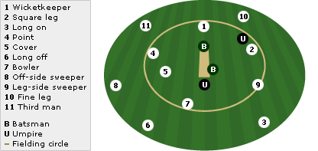
Cricket Abstarct

Slide 32
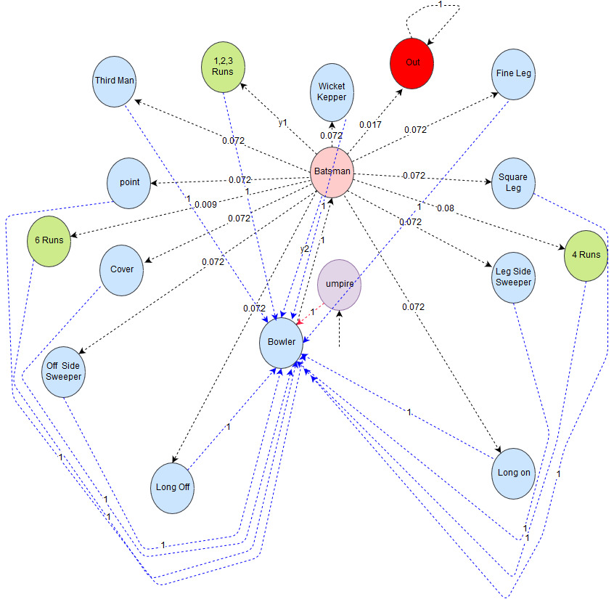
Cricket Model

Slide 33
PCTL PROPERTY
What is the probability of Virat Kohli scoring atleast 1.55 run per ball on an average ?
R _{≥1.55} [ F (q=16)]
runs

Slide 34
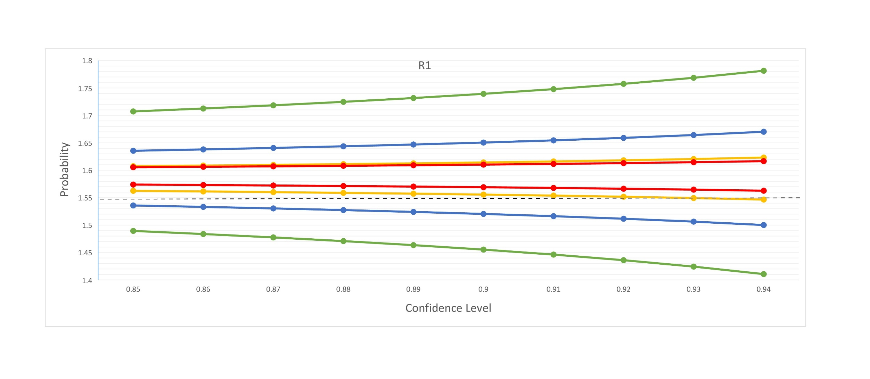
CRICKET Result

Slide 35
Water Filter
Pre-sediment filter : Removes mud, visual impurities.
Sediment filter: Removes remaining visual impurities, fine dust impurities, fine dust particles and clay.
Pre- carbon filter: Removes chlorine, lead, pesticides, heavy metals, bad taste, odour.
Reverse osmosis: Removes germs, microbes, excessive salts.
UV chamber: KILL THE REMAINING GERMS!
Ultra filtration: Any other leftover germs , collids is removed.

Slide 36
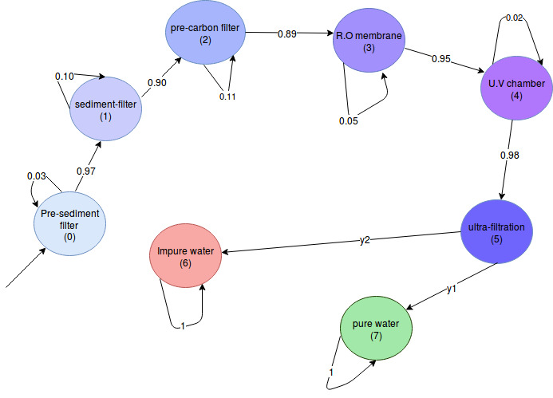
Water Filter Model

Slide 37
Water Filter
How did we proceed?
As described in the paper, we wrote our own model simulator and input the parametric MC to note down the observations.
The observations were used along with the PCTL query that captures what my requirements into the FACT TOOL CHAIN.
The FACT TOOL CHAIN generates the probability range for corresponding confidence intervals.

Slide 38
PCTL PROPERTY
What is the probability of getting pure water atleast 96% of the time?
P _{≥0.96} [ F (q=7)]
runs

Slide 39
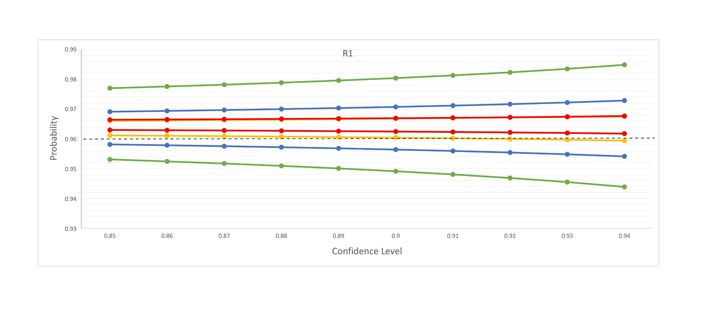
Water filter Result

Slide 40
CONCLUSION
For any fixed number of observations , the width of the confidence interval increases supralinearly with the confidence level (1-α)
The width of the interval [bestA,bestB]computed by the Algorithm 1 is much smaller in experiments with larger observation sets.
Clearly, the number of observations required to establish if the system complies with its QoS requirements with a fixed level of confidence is influenced by how close the requirement bounds are to the actual (unknown) value of the associated QoS property

Slide 41
CONCLUSION
Hill climbing optimization can improve the precision of confidence intervals significantly, enabling a more accurate analysis of QoS properties.
The time taken to establish confidence intervals using the FACT toolset is dominated by the confidence interval inference stage. The average time required for one execution of optimization step ranged between 2.33 s and 3.04 s.

Slide 42
FUTURE WORK
The number of parameters is very less in the test cases we have discussed. To further extend this project we can totally remove the probabilities associated with the edges and replace all of it with parameters.

Slide 43


Slide 44


